Slide 1
Predicting the claim size of liability insurance claims
Amith Prasad

Slide 2
TORT REFORM w.r.t INSURANCE
Tort reform refers to proposed changes in the civil justice system that aim to reduce the ability of victims to bring tort litigation or to reduce damages they can receive.
Stakeholder:
Claimants
Insurers
Lawyers
Consumer Activists

Slide 3



InSURANCE CLAIMS CATEGORIES
> 200K
< 100K
100K to 200K

Slide 4
PreProcessing: Strange Dataset
3 sets of data
Claim id and the claim category(target)
Claim Details, having type of injury and other claim related details
Policy Demographics, having policy details
Using ClaimId as foreign key merged the dataset
65 features
35 features having 80% or more missing values
5 features having 30-70% missing values

Slide 5
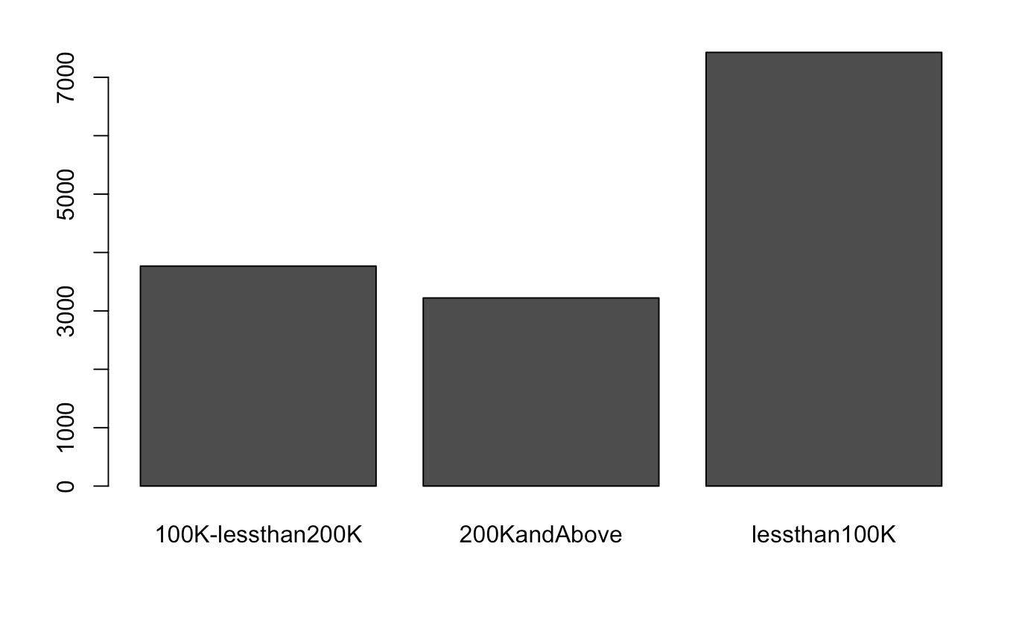
Distribution of Claim Size
There seems to be a class imbalance, where “lessthan100K” values being twice as that of the rest
Solution: Stratified Sampling

Slide 6
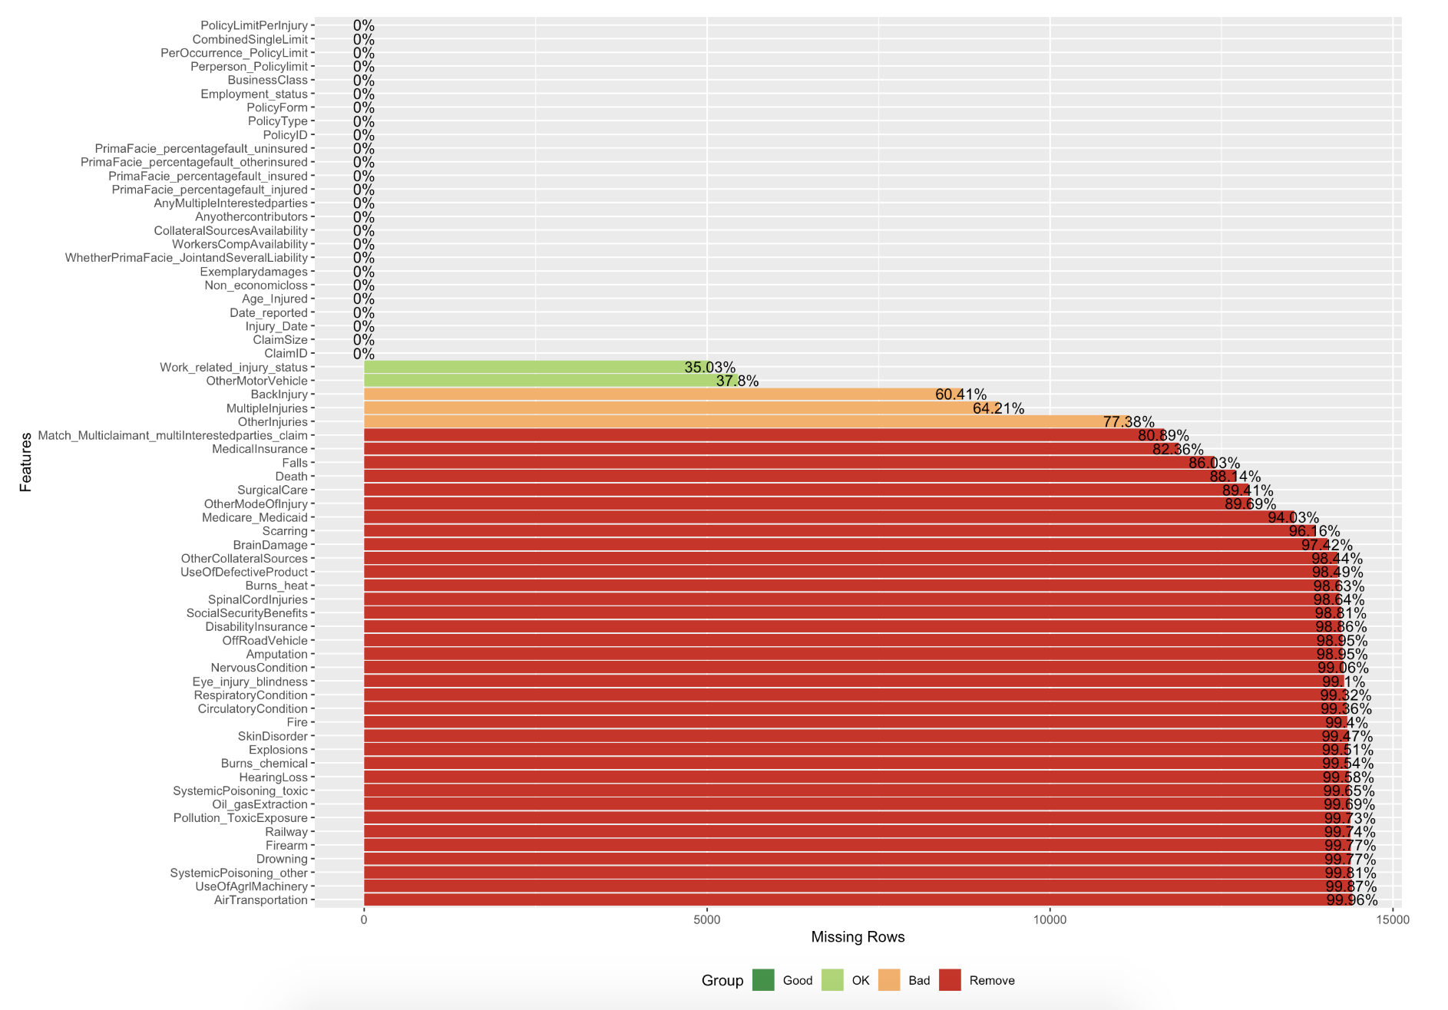
FEATURE SELECTION BASED ON MISSING VALUES

Slide 7
IMPUTE or NOT?
Since this is INSURANCE data and assuming an injury occured or not(Example) based on some other rows doesn’t seem like a legit imputation
So bucketing all NAs to a value say “Don’t Know” where possible, rest leaving it to the model to handle it.

Slide 8
To Scale or Not?
Numerical data can be scaled
Distance Based algorithms require data to be scaled
PCA
KNN
SVM
Tried with and without scaling for Tree Based Algo as well
Without scaling resulted in better Accuracy(Random Forest and XGBoost)

Slide 9
What model to run?
A million dollar question.
Tried many classification models:
Logistic Regression (multinom)
Naive Bayes
KNN
SVM
Random Forest - Best Result
XGBoost
Gradient Boost

Slide 10
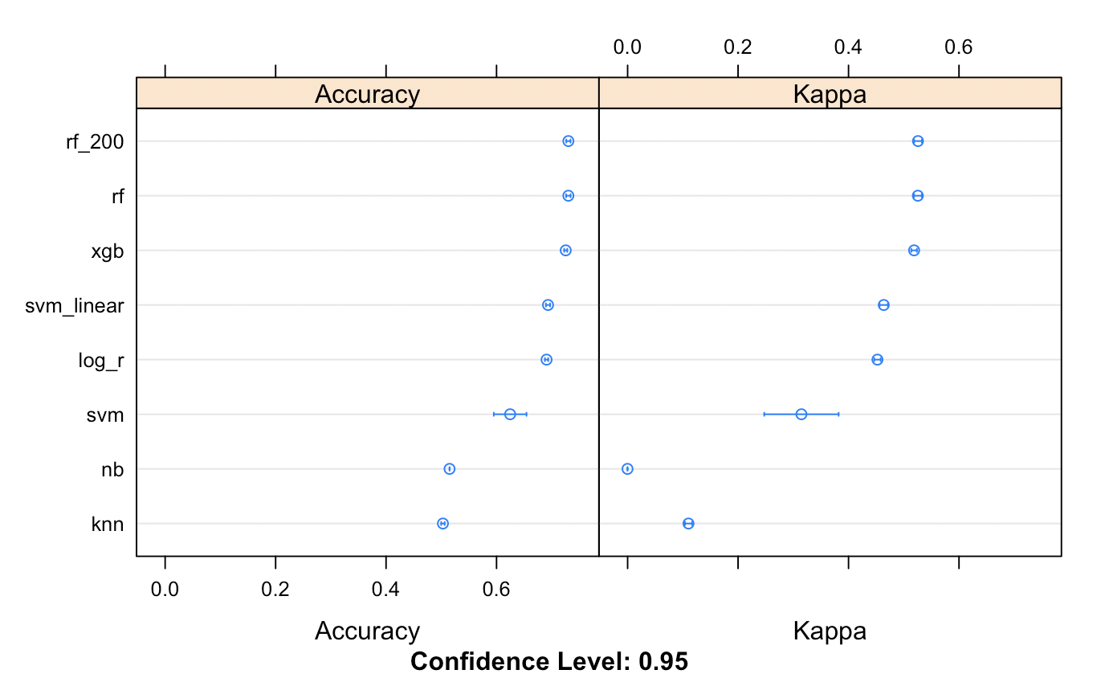
How to decide which Model is best?
Random Forest gave the highest accuracy.
Tuned the hyper parameter
ntree with 200 and 500 and the accuracy was almost same

Slide 11
Stacking
Stacked: log Reg + NB + KNN + SVM + RF + XGB
Stacked Level 2: GBM
Stacked: log Reg + NB + KNN + SVM + RF + XGB
Stacked level 2: GBM + RF
Stacked level 3: XGB
Conclusion: Did not see any improvements

Slide 12
Max Accuracy
Accuracy: 73.68
Model: Random Forest
Hyperparameters:
ntree: 500
seed: 500
mtry: 6

Slide 13
Future Work
Try applying PCA
Tune more parameters of XGB and Random Forest
Find ways to incorporate Date column

